Slide 1


Constraining the KS Axiverse with Astrophysics
David J. E. Marsh
StringPheno 2022, Liverpool

Slide 2
Collaborators
Viraf Mehta, Matthew J. Stott, Mehmet Demirtas, Cody Long, Liam McAllister
Naomi Gendler, Jakob Moritz, James Matthews, Sebastian Hoof

Slide 3

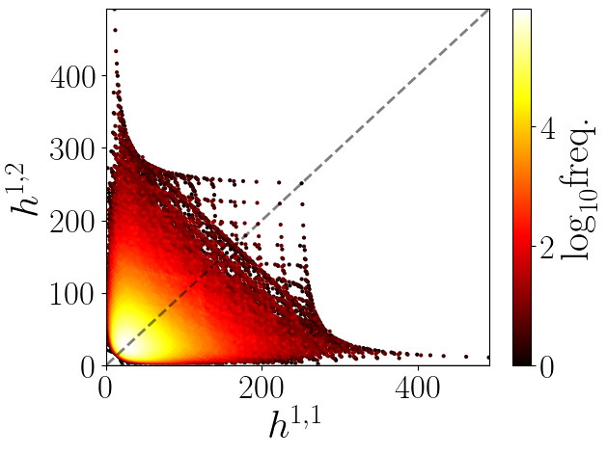
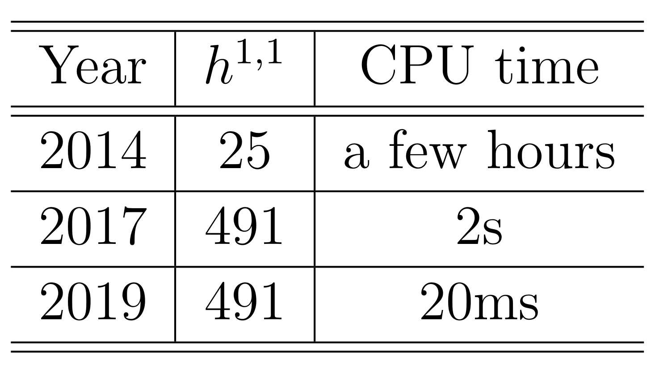
The KS Axiverse
Demirtas et al (1808.01282)
See talks: McAllister, Rios-Tascon, Moritz
Triangulate (FRST) KS polytopes → CY₃. 1000’s of CYs at large h¹¹ in laptop-time!
Pick point in Kähler cone (no stabilization).
Kähler metric and axion potential computed:
h11=27: most polytopes
h11=491: most CYs
e.g. GKZ elements for a 491 triangulation
For an astrophysicist: databases of K, Λ, Q sampling KS, triangulations, and Kähler cone.
Aim: rigorously exclude CY’s based only on vacuum properties of the axions.

Slide 4
Axion Spectra
See/you have just seen: Mehta’s talk
Mass: nearly scale invariant
Find vacua of V(φ) in fundamental domain. Expand to quartic order → masses +quartics (“fpert”).
Not shown: ~70% of m<H₀ fields (!). Constant at large h^{1,1}.
Trends: Kähler cones become very narrow at large h11 → cycles in the CY have large volumes → (ultra)light axions and smaller decay constants.
Hodge Number h11
f: log-normal ~ K eigs
“Bunching” due to missing massless fields

Slide 5
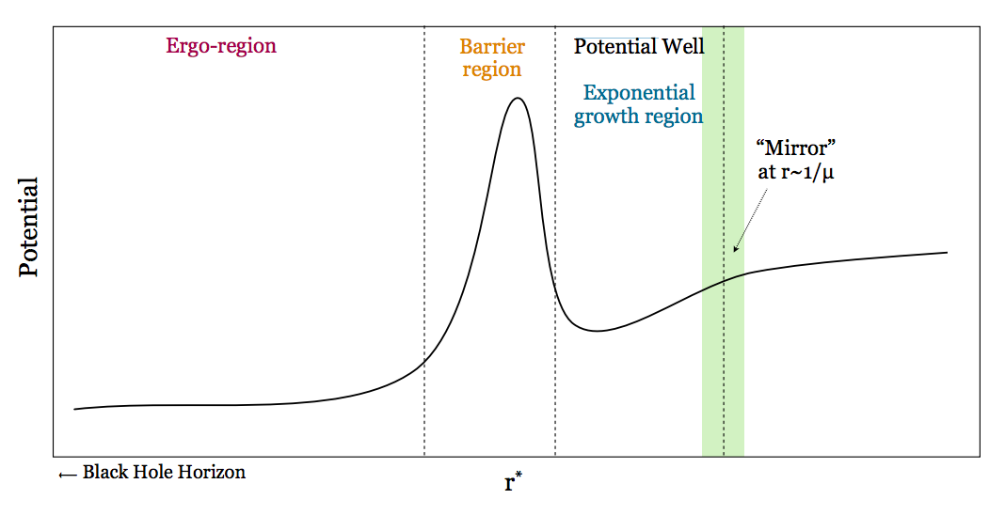
Black Hole Superradiance
Review: Brito et al (2015)
See Shiu’s talk for thermodynamics
Solve for instabilities of KG equation on Kerr:
Physical picture: “Penrose process/ black hole bomb”
Non-relativistic limit in “tortoise coords”, find instability (ω<0):
Fig: Arvanitaki & Dubovsky (2010)
Resonant bosons extract spin from astrophysical BHs, if Γ_{SR}>Γ_{others}

Slide 6
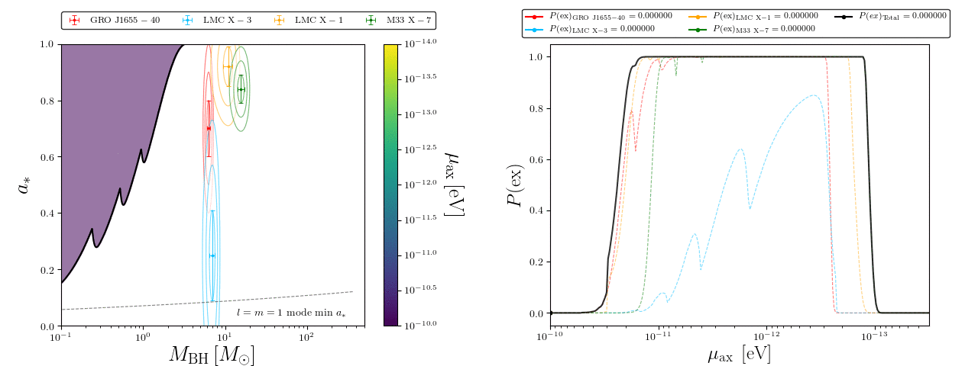
Spin-0 Fields, No φ⁴ Term
GIF by Matthew J. Stott
“Exclusion probability” is marginal likelihood. Statistically robust constraints (see bonus slides).

Slide 7
Gap due to no known intermediate mass BHs
Stott & DJEM (2018)

Slide 8
φ⁴ Instability: “Bosenova”
Yoshino & Kodama (2012); Arvanitaki et al (2014); Stott (2018)
Bose enhanced 2-2 scattering in superradiant cloud can have a rate Γ₄>Γ_{SR}.
Shuts off SR by cloud collapse above critical value of λφ⁴ coupling. Interpret as λ=m²/f²_{pert}.
Approximate excluded regions:
Stellar BHs:
Supermassive (SM) BHs:
Implemented here with a simple cut-off. See Baryakhtar+ for more advanced rate calcs. Quantitatively similar.

Slide 9
Constraints on IIB CY Vacua
Mehta, DJEM et al (2021)
Ensemble of O(10⁵) CYs. All up to h11=5. 100 per h11 up to 176. Up to 100 per h11 to 491.
The first rigorous use of the “axiverse” idea to test string theory.
Trend easily understood from falling K eigs at large volume → Bosenova shut-off

Slide 10
Beyond Superradiance
Why superrradiance? Vacuum process, no cosmological assumptions. Only need the axion potential.
Why go further? Large h11, and moduli space away from Kahler cone tip → larger volume → lower decay constants → superradiance shuts off.
What observables will be best? Ideally vacuum processes, cosmology independent, exploit massless fields.
What is a bad observable? Unfortunately, axion DM from realignment: too many cosmological assumptions. See, however, Cicoli talk; Bauer, DJEM et al (2020) [and bonus slides].

Slide 11
Axion Renaissance
Fig: Ciaran O’Hare, AxionLimits github
Similar story for other axion coupling
Global fits and computations for many observables: GAMBIT collaboration (Seb Hoof)

Slide 12
Axion Renaissance
Fig: Ciaran O’Hare, AxionLimits github
Similar story for other axion coupling
… but I’m not going to talk about axion DM today.

Slide 13
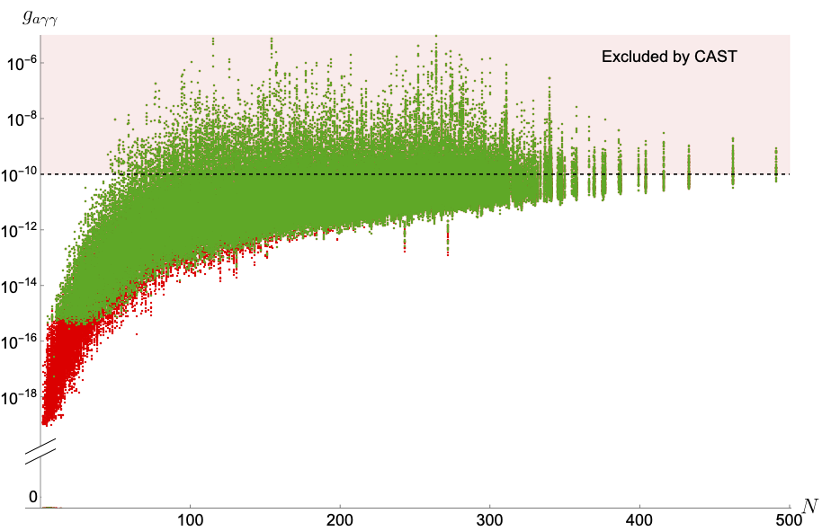
Visible Sector Couplings
“PQ Axiverse”: Demirtas et al (2021)
See talk by Jakob Moritz
Choose divisor for QCD. Dilate V until divisor volume → α_{QCD}. Demand geometric.
Axion masses and f’s by using hierarchy of instanton scales + Kähler metric.
Strong-CP: Σ_{i}θ_{i} in front of CS must be small.
Assuming a GUT you can find g_{aγ}:
3e4 random CYs
Computationally limited at large h11
(ci’s known)
Too much realignment DM
Effective axion-photon coupling for massless linear combination
Hodge Number h^{1,1}

Slide 14
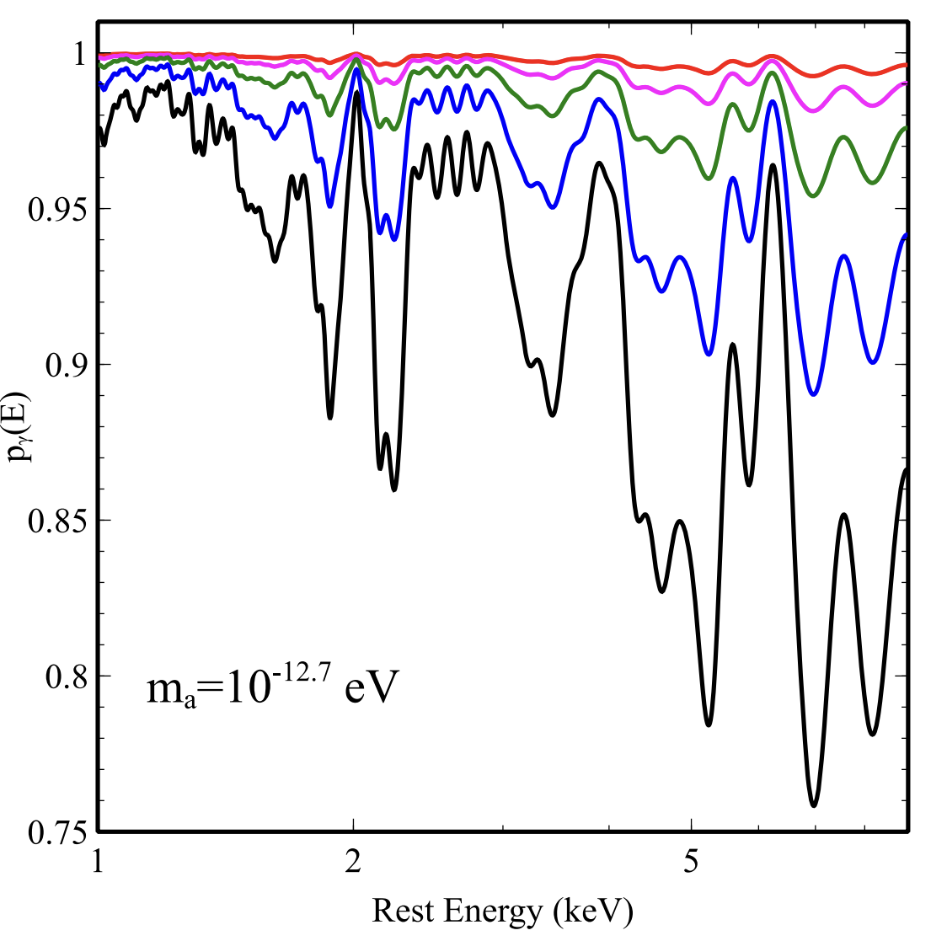


X-ray Spectrum Oscillations
e.g. Matthews et al (2022); Reynolds et al (2020)
Conlon+; “other David Marsh”
Photon-axion conversion in cluster B-fields → spectrum oscillations. Vanishing if m_{a}>ω_{p}. Need to marginalize random magnetic field models. Fit Chandra satellite data.
Best limits on g at low mass. Complementary to BHSR. Marginal likelihood obtained from Cambridge group.

Slide 15

Freeze-in DM & Decays
GAMBIT collab., inc. DJEM, 2205.13549
Axion production via Primakoff process off SM charged particles from vacuum initial state.
Irreducible contribution to DM, all fields with m<reheat temperature. Must not “overclose”.
Perturbative decay → photodissociation of elements, cosmic reionization etc. even for ξ~10⁻¹⁰.

Slide 16
(very) Preliminary Results
String Datasets:
PQAxiverse: conditioned on correct QCD coupling and strong-CP. Masses and visible sector couplings estimated. O(10) CYs at h11=491.
h11=491: exploratory dataset, O(10⁵) CYs. Zeroth order assumption: massless axions, estimate couplings from Kähler eigs only. Tip of Kähler cone → smaller couplings than the bulk → limits conservative.
Astrophysical Datasets:
Chandra: X-rays effective likelihood for single massless axion. Ignore CYs with any resonant axions. Future: modify ALPro for one axion in resonant region + massless.
Freeze-in DM: crude cuts on overclosure and decaying DM (PQAxiverse only). Future: build cosmological likelihoods using micrOMEGAS and GAMBIT.
Astro and stats: rigorous by StringPheno 2024 ☺

Slide 17
PRELIMINARY
PQ Axiverse
Favour lower reheat T to open parameter space c.f. Cicoli talk.

Slide 18
Numerical floor
h11=491
PRELIMINARY
PRELIMINARY
Numerical floor
PQ Axiverse
20% favoured if h¹¹<200. Spectrum overfitting.
Zero allowed manifolds h¹¹>250.
All randomly sampled CYs at 491 are strongly excluded (saturate likelihood).
Recall: tip of SKC → limits are likely conservative over moduli space (!)

Slide 19
Speculations and Hopes
Triangulations (CYs) of 491 polytope obeying constraints are VERY rare. Probably true of most of moduli space. Astrophysics prefers “boundaries” of KS axiverse.
Can we use ML techniques to find allowed models at 491?
Is there a symmetry underlying this? Can we use to ML to find it?
If there is a symmetry → restrict combinatorics that count the CYs at 491 → make a brute force exploration of remaining 491 landscape possible?
Because we’re here: connection of astrophysical limits (→ small f) to WGC? Meaning/consequence of large number of nearly massless fields? Generic cosmology from heavy axions? Beyond Type-IIB?
See Goodsell talk (applied to LHC)

Slide 20





Topology from cosmology: axions, astrophysics, and machine learning
Seeking two postdocs. Two year positions in London (KCL and LIMS).
Extended visits to Cornell and Northeastern. Please enquire/tell your colleagues!

Slide 21
Backup slides

Slide 22
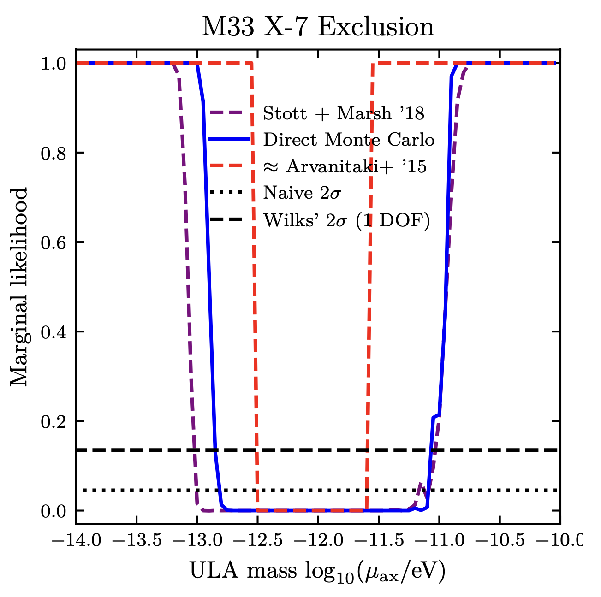
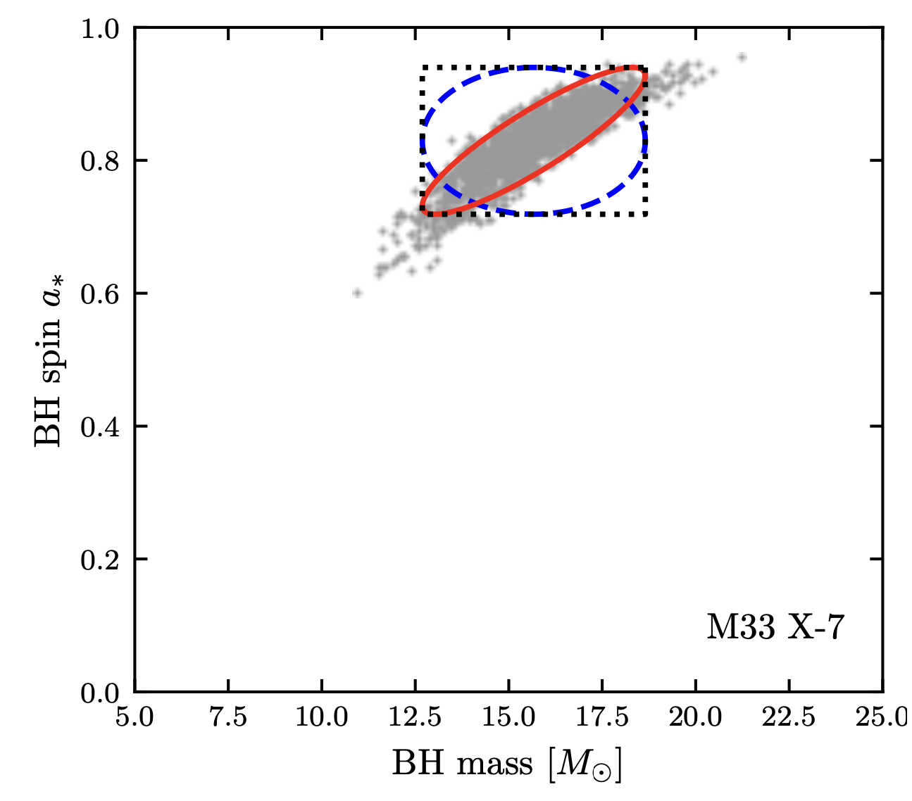
Statistical Approaches to BHSR
w/ Seb Hoof
Arvanitaki
DJEM+Stott
Gaussian-cov
Samples
Arvanitaki+ use a crude “box” exclusion: overly conservative limits.
Our method: approximate (or exactly sample) the marginal likelihood → more powerful limits.

Slide 23
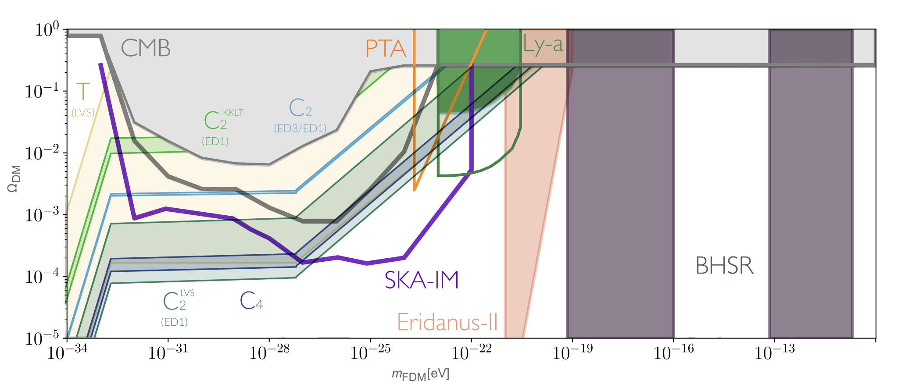
Fuzzy Dark Matter
Cicoli et al (2021); Bauer DJEM et al (2020)
Recent cosmology: see SNOWMASS 2203.07064
Future cosmological measurements of 21cm intensity mapping by the square kilometer array sensitive to DM sub-pop. of ultralight axions if f~10¹⁶ GeV. Explicit models recently found.

Slide 24
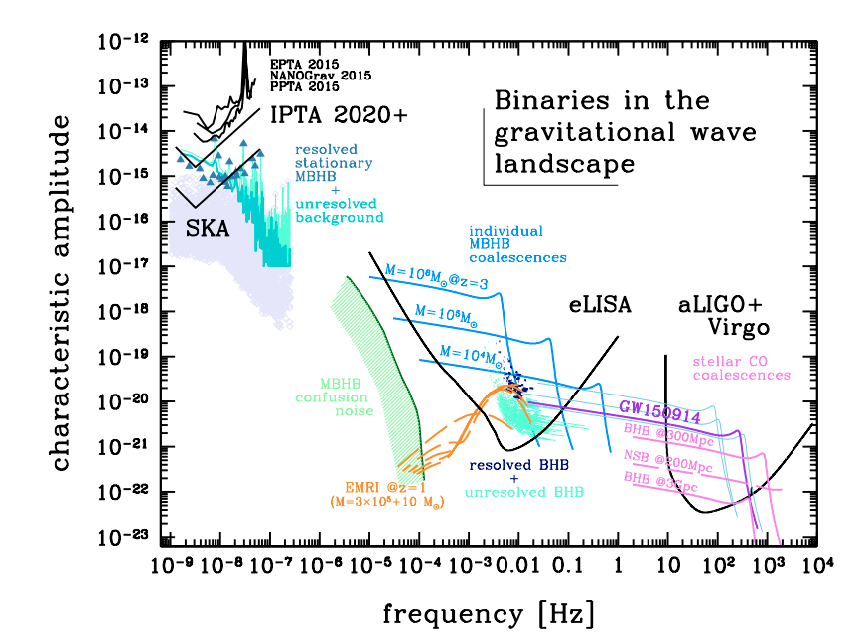
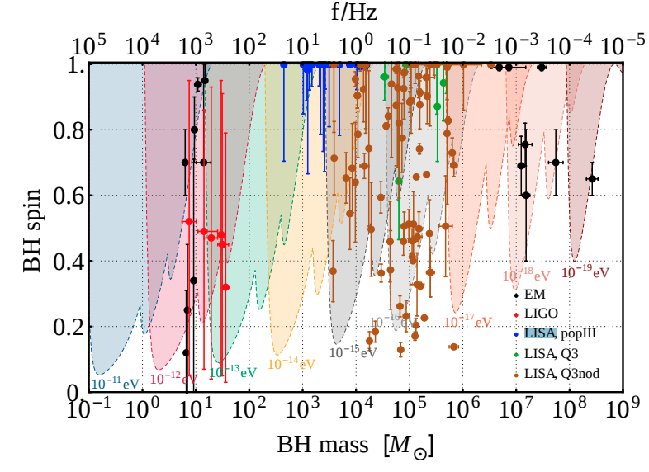
LISA and Intermediate Mass BHs
IMBH binaries enter LISA band during inspiral.
IMBH binaries predicted from Pop-III & measurable by LISA.
Colpi & Sesana (2016)
Brito et al (2017)

Slide 25
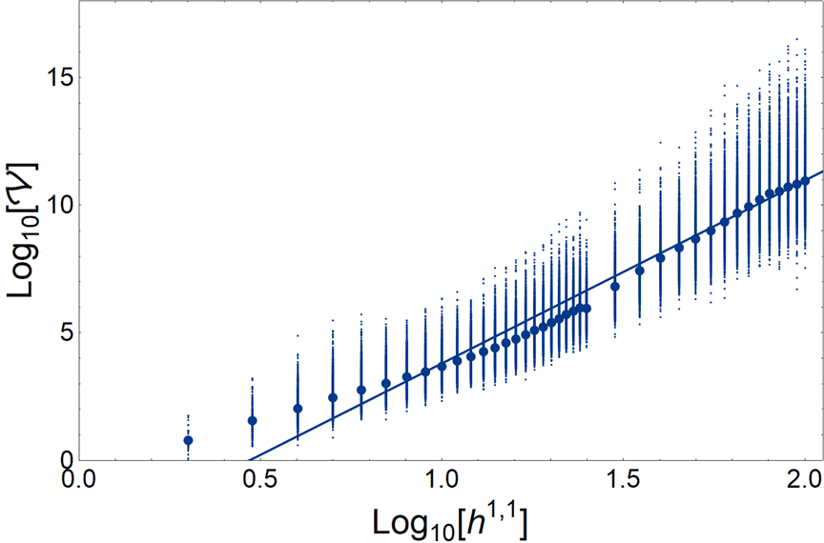
Volume-h11 Trend in KS Axiverse

Slide 26
Dark Radiation
e.g. Baumann et al (2016)
Planck Collaboration, Parameters (2018)
Freeze-in DR as massless combination of axions thermalizes → one d.o.f. → small ΔN_{eff}
Could get more from e.g. modulus decay. More model dependence.
[e.g. Acharya+, Iliesu, DJEM+, Cicoli+]

